Slide 1
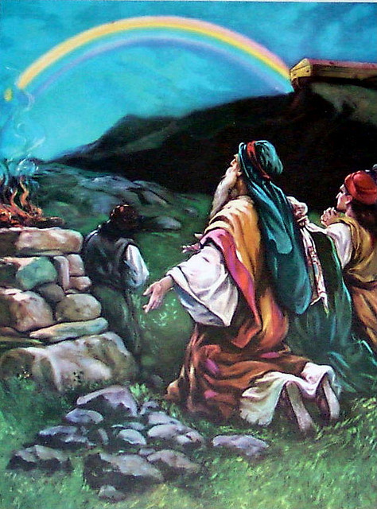
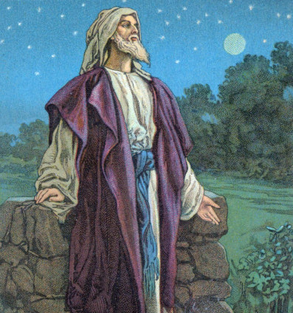
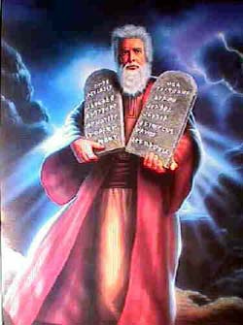
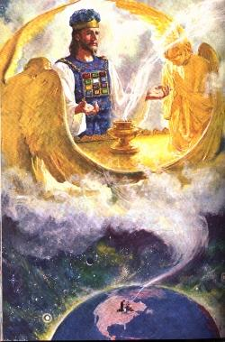
OUR ROLE IN GOD’S COVENANTS – Part 1
Moses
Jesus
Noah
Abraham

Slide 2

Great is Thy Faithfulness Hymn # 356

Slide 3
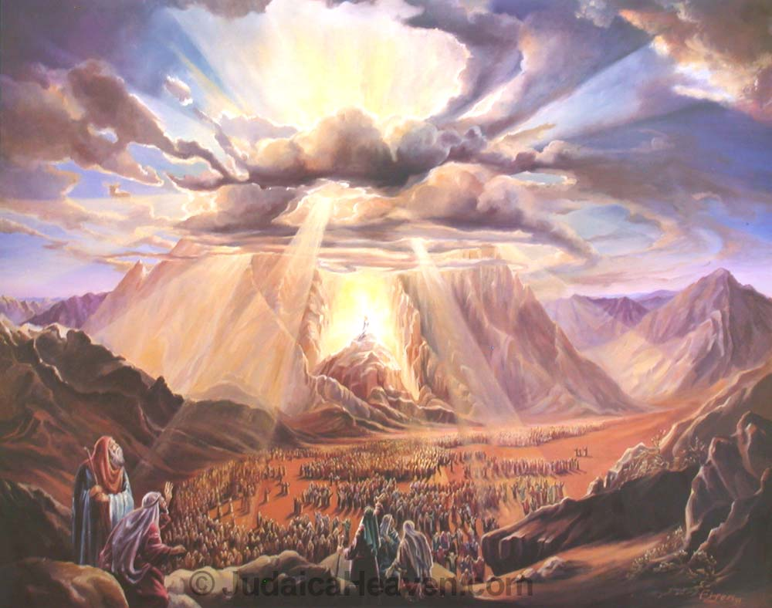
"Great is Thy faithfulness," O God my Father,
There is no shadow of turning with Thee;
Thou changest not, Thy compassions, they fail not,
As Thou hast been Thou forever wilt be.

Slide 4
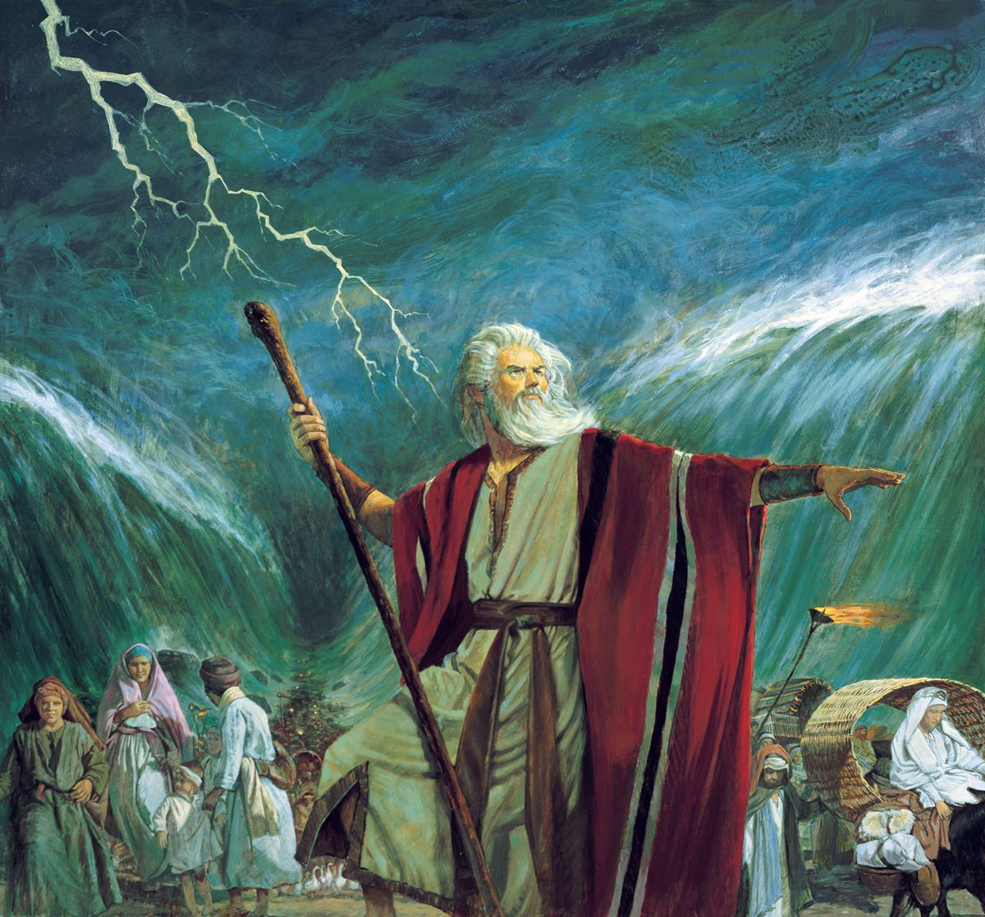
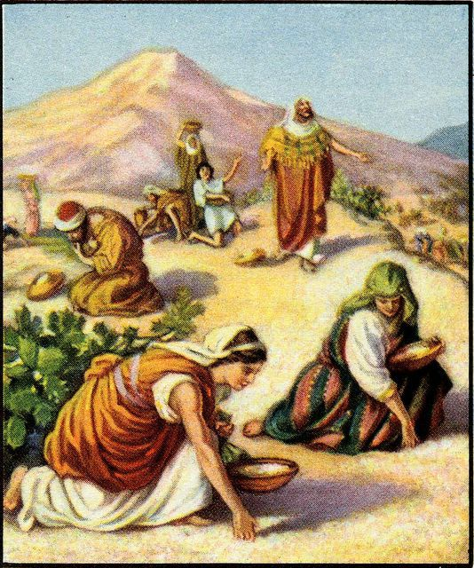
Great is Thy faithfulness! Great is Thy faithfulness!
Morning by morning new mercies I see;
All I have needed Thy hand hath provided,--
"Great is Thy faithfulness," Lord, unto me!

Slide 5
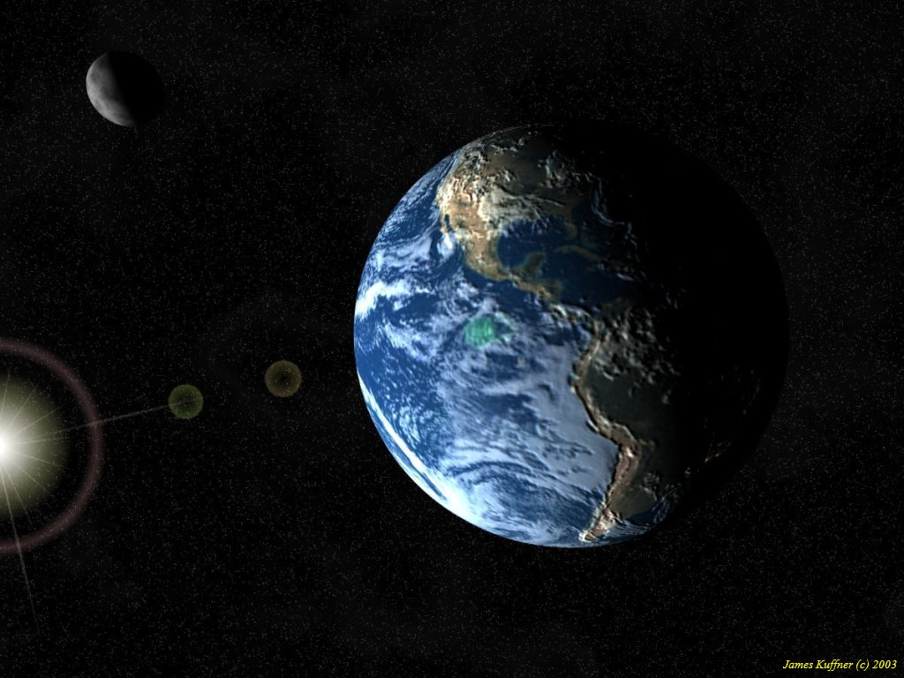
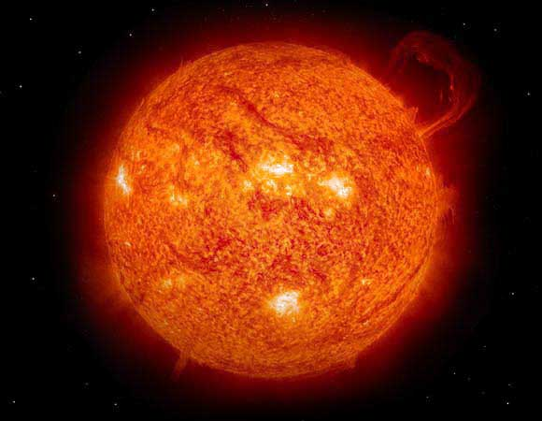
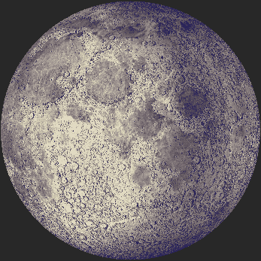
Summer and winter, and springtime and harvest,
Sun, moon and stars in their courses above,
Join with all nature in manifold witness,
To Thy great faithfulness, mercy and love.

Slide 6
Great is Thy faithfulness! Great is Thy faithfulness!
Morning by morning new mercies I see;
All I have needed Thy hand hath provided,--
"Great is Thy faithfulness," Lord, unto me!

Slide 7
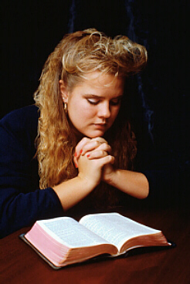
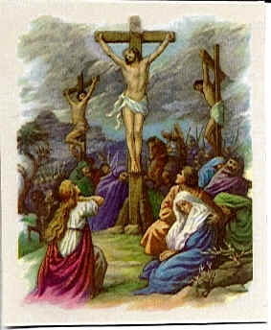
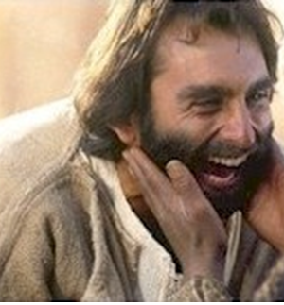
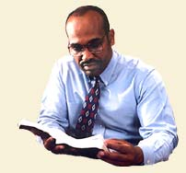
Pardon for sin and a peace that endureth,
Thine own dear presence to cheer and to guide;
Strength for today and bright hope for tomorrow,
Blessings all mine, with ten thousand beside!

Slide 8
Great is Thy faithfulness! Great is Thy faithfulness!
Morning by morning new mercies I see;
All I have needed Thy hand hath provided,--
"Great is Thy faithfulness," Lord, unto me!

Slide 9
OUR ROLE IN GOD’S COVENANTS – Part 1
Moses
Jesus
Noah
Abraham
Notes:
Today, in Part 1, we would like to first discuss God’s covenants in general, then next how any of these covenants may relate to us, and finally, we want to answer the question, “Who is under the New Covenant?”

Slide 10
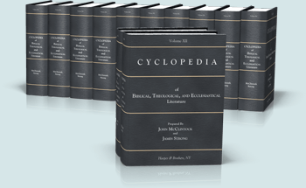
WHAT IS A COVENANT?
McClintock and Strongs, Vol 2, pg 543, Covenant: "a mutual contract or agreement between two parties, each of which is bound to fulfill certain engagements to the other."
Notes:
[Read screen]
So a covenant is a contract in which each party has a mutual obligation to complete a service on behalf of the other party. Take Israel's Law Covenant for an example.

Slide 11
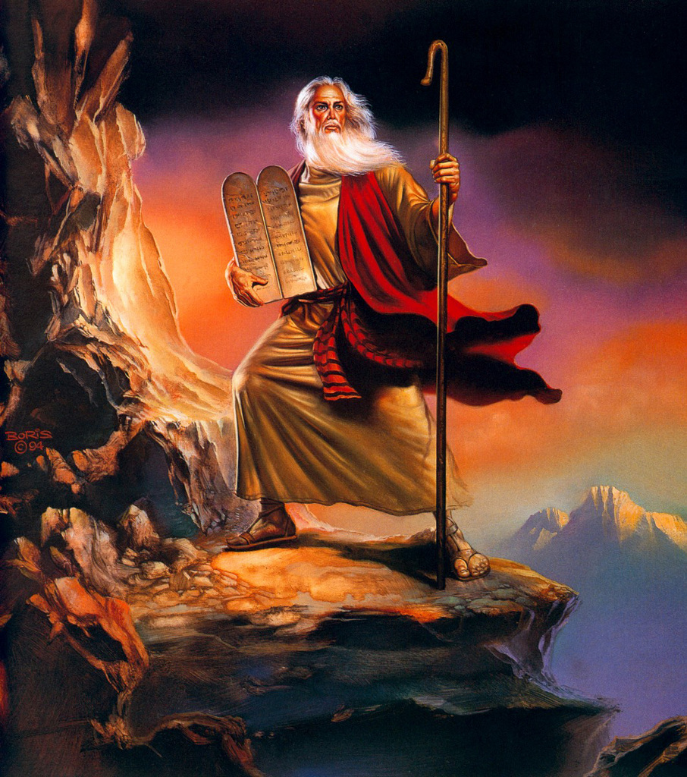
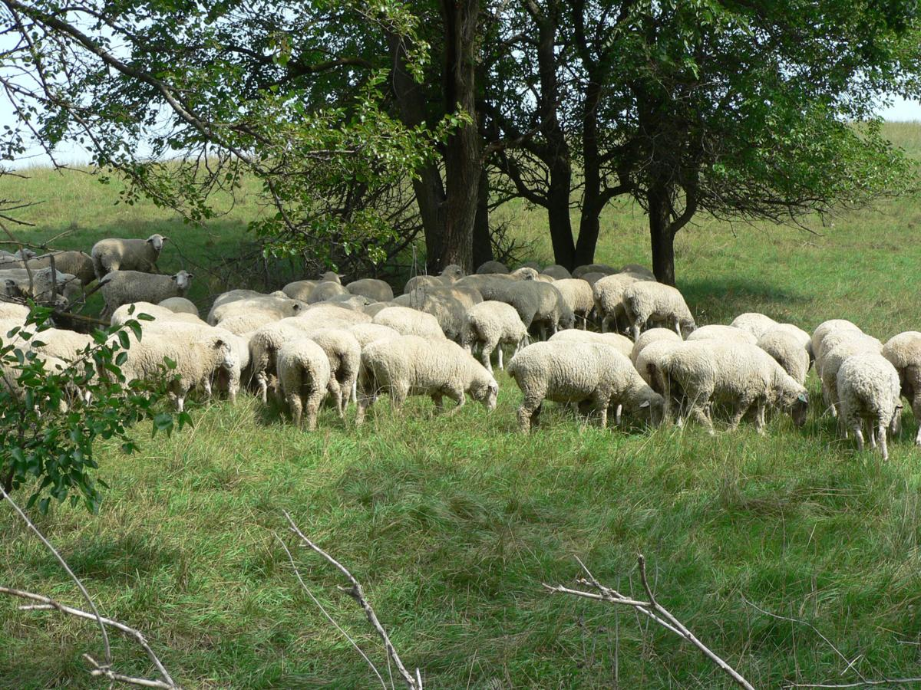
Deut 28:2 (AV) “And all these blessings shall come on thee, and overtake thee, if thou shalt hearken unto the voice of the LORD thy God.”
Notes:
[Read Deut 28:2]
Duet 28 shows that if Israel would obey God, He would bless them with rain, flocks, produce, health and protection from their enemies; but if they would disobey, the opposite would occur.

Slide 12
Deut 28:2 (AV) “And all these blessings shall come on thee, and overtake thee, if thou shalt hearken unto the voice of the LORD thy God.”
Rom 10:5 (RVIC) “For Moses writeth that the man that doeth the righteousness which is of the law shall live thereby.”
Notes:
As a matter of fact, if Israel could follow the law perfectly, they could have eternal life.
[Read Rom 10:5].

Slide 13
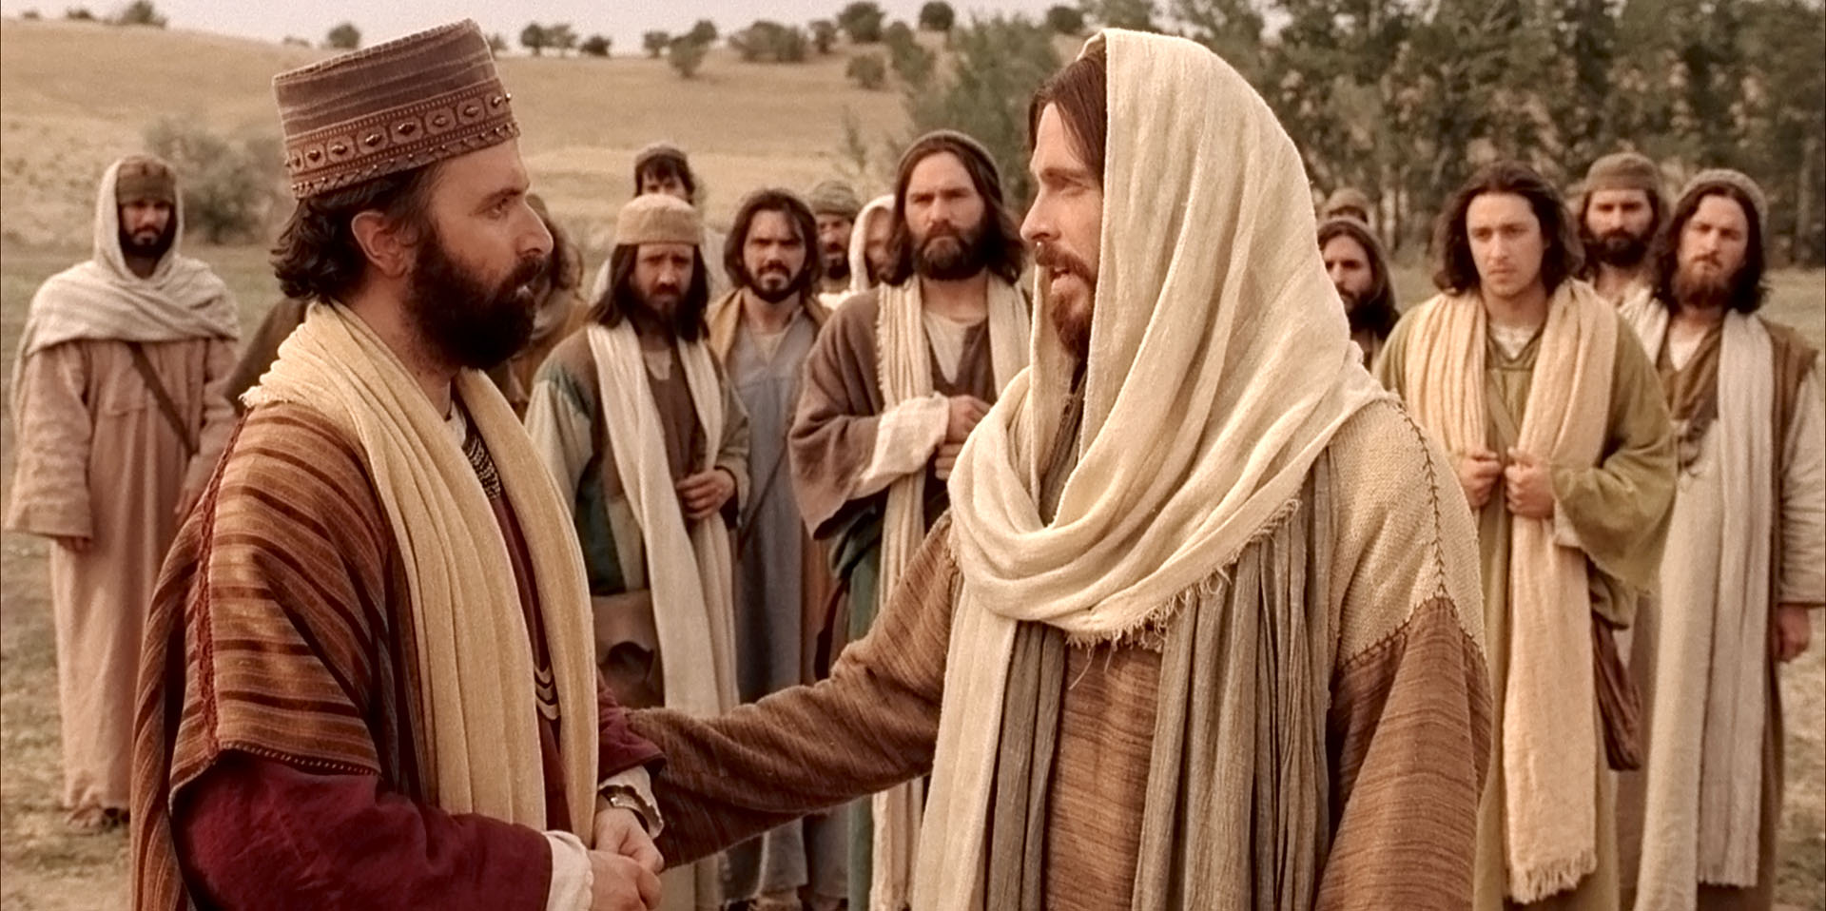
Luke 18:18 (NKJV) “Now a certain ruler asked Him, saying, "Good Teacher, what shall I do to inherit eternal life?”
Notes:
Jesus confirms this. [read verse]

Slide 14
Luke 18:18 (NKJV) “Now a certain ruler asked Him, saying, "Good Teacher, what shall I do to inherit eternal life?”
Luke 18:20 (NKJV) "You know the commandments: ‘Do not commit adultery,’ ‘Do not murder,’ ‘Do not steal,’ ‘Do not bear false witness,’ ‘Honor your father and your mother.’"
Notes:
[read Luke 18:20]
Jesus said [read Luke 18:20] If the ruler could perfectly keep the law, he could have had eternal life. Yet truthfully, no one could perfectly keep the law, hence all died.

Slide 15
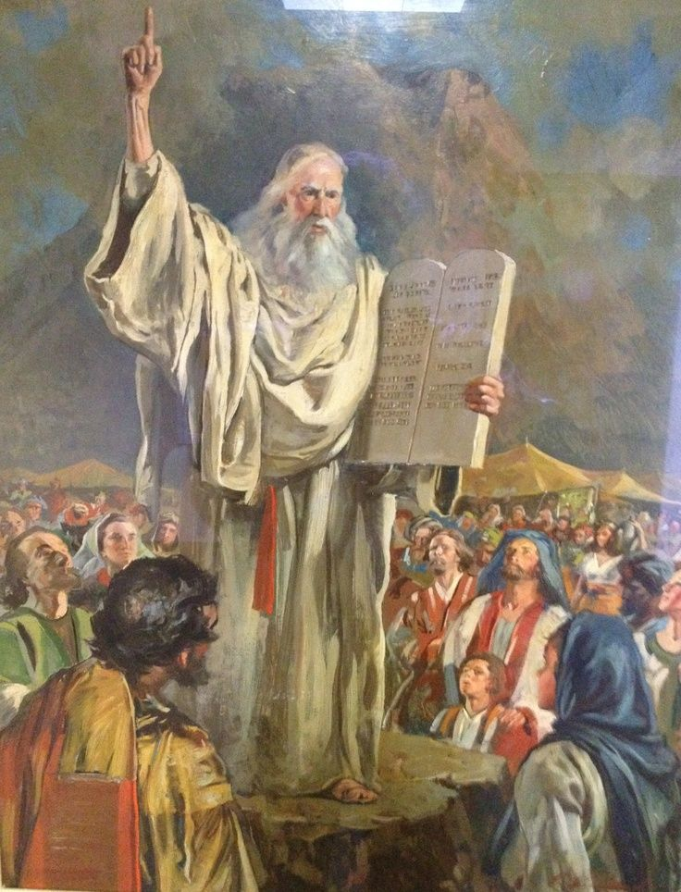
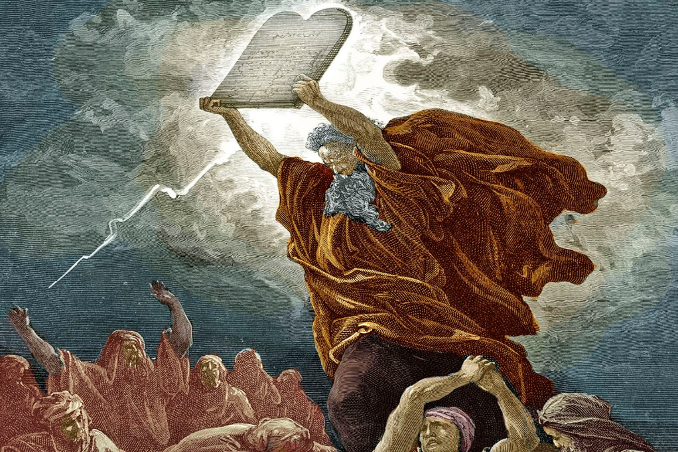
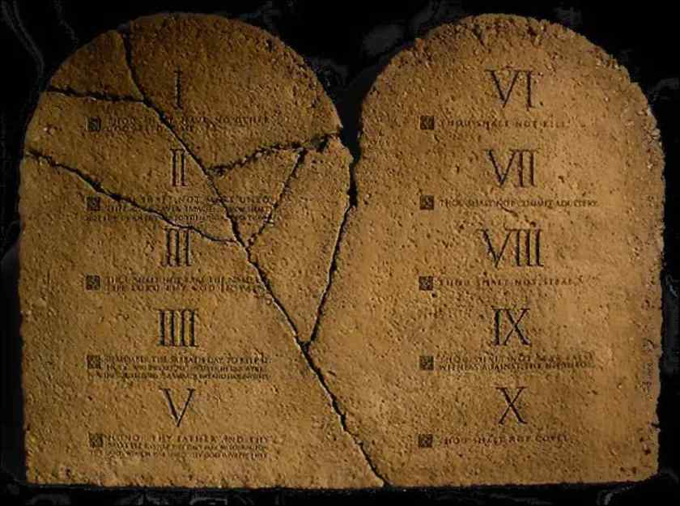
Galatians 2:16 (NKJV) “…a man is not justified by the works of the law but by faith in Jesus Christ…”
Galatians 3:11 (NKJV) “But that no one is justified by the law in the sight of God is evident, for "the just shall live by faith."
Notes:
We find confirmation in Galatians that no person could succeed in being justified by the law. Hence they all died as sinners. [read verses]

Slide 16
MAJOR COVENANTS OF THE BIBLE
Abrahamic Covenant Law Covenant New Covenant
Notes:
We often think of the three major covenants of the Bible. These are:
1) The Abrahamic Covenant - God’s promise to bless all the families of the earth through Abraham’s seed.
2) The Law Covenant – The law of Moses that God made with Israel on Mount Sinai, which includes the Ten Commandments.

Slide 17
MAJOR COVENANTS OF THE BIBLE
Abrahamic Covenant Law Covenant New Covenant
Notes:
3) The New Covenant – The future covenant God will make with Israel and mankind during the earthly kingdom in which God will write His laws in the peoples minds and hearts.
There is also one more major covenant in the Bible. It is
4) God's Covenant with Noah to never again destroy all life on the earth.

Slide 18
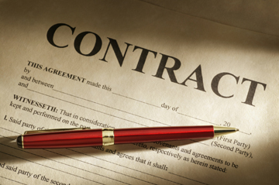
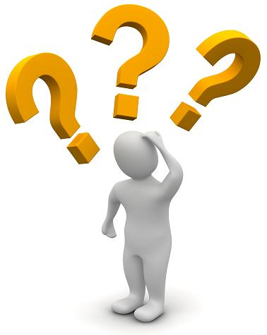
ARE ALL BIBLE COVENANTS CONDITIONAL?
Notes:
[Read question]
In other words, do all Bible covenants require both parties of the covenant to fulfill certain obligations?
NO. Not all Bible covenants are conditional.

Slide 19
The Rainbow covenant with Noah was NOT conditional
In Gen 9:11 (NASV), God said, "I establish My covenant with you; and all flesh shall never again be cut off by the water of the flood, neither shall there again be a flood to destroy the earth."
Notes:
For example, God made an unconditional covenant with Noah to never again destroy all life on the earth.
[Read verse]
No strings were attached. No conditions were required. God simply made this promise to Noah and set the rainbow in the sky as a sign of it.

Slide 20
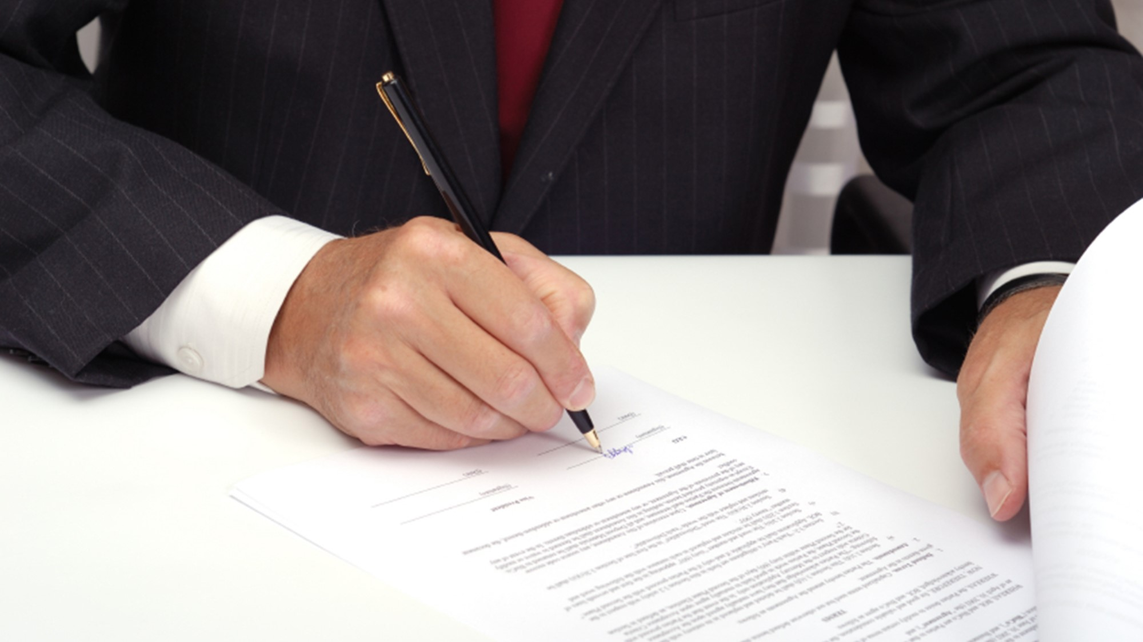
WHEN DOES A COVENANT GO INTO EFFECT?
Notes:
[Read question]
A covenant can go into effect, only after it has been ratified. To ratify a covenant means to confirm it or to guarantee it. Today we ratify a contract with signatures. In Old Testament times a covenant was often ratified by animal sacrifices.

Slide 21
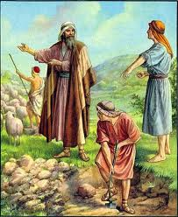
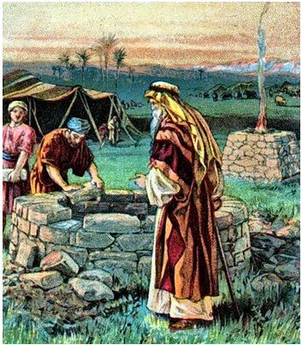
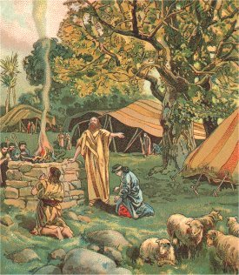
ABRAHAM MAKES A COVENANT WITH ABIMELECH
Genesis 21:27: “And Abraham took sheep and oxen, and gave them unto Abimelech; and they two made a covenant.”
Notes:
An example of ratifying a covenant is illustrated in Gen 21:22-34. Here Abraham made a covenant with Abimelech, that the well at Beersheba would belong to Abraham and that Abimelech's servants would no longer use it. The two parties sacrificed sheep and oxen to ratify the covenant. Notice the word “made” where it says, “made a covenant.”
[Read Gen 21:27]

Slide 22
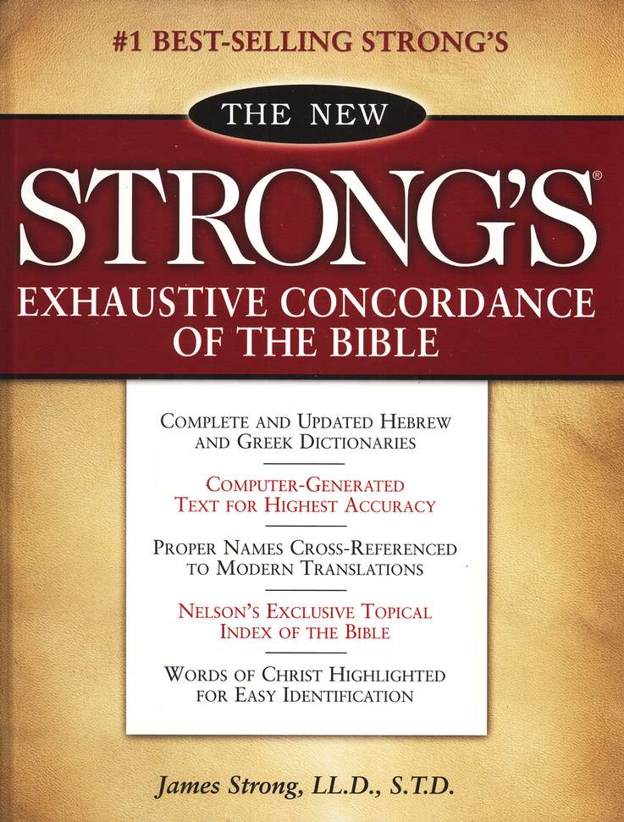
The Hebrew word for "made" is "karath".
Strong’s 3772: a primitive root; to cut (off, down or asunder); by implication to destroy or consume; specifically to covenant (i.e. make an alliance or bargain, originally by cutting flesh and passing between the pieces).
Notes:
The Hebrew word for "made" in Genesis 21:17 is "karath". Strong’s gives the following definition:
[Read underlined definition]

Slide 23
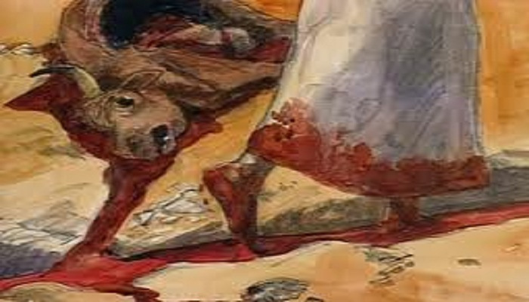
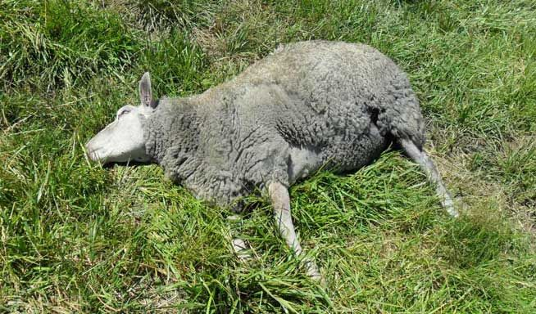
COVENANT SACRIFICE RATIFIED BY WALKING BETWEEN THE CUT PARTS
Gen 15: “[Abraham] 10 cut them [the animals] in two, down the middle, and placed each piece opposite the other… 17 … a burning torch that passed between those pieces. 18 On the same day the LORD made a covenant with Abram…”
Notes:
Often the sacrificed animal would be cut in parts; each half was laid on the ground with some space between them. The covenant makers would then walk between the cut parts, thereby ratifying the covenant. This was how God ratified the Covenant with Abraham as recorded in Gen 15:9, 10, 17, 18.
[Read Gen 15]

Slide 24
COVENANT SACRIFICE RATIFIED BY WALKING BETWEEN THE CUT PARTS
Jer 34:18: “… the covenant which they made before me, when they cut the calf in twain and passed between the parts thereof..."
Notes:
Jeremiah speaks in figurative terms of ratifying the Law Covenant:
[Read verse]
Again, the thought of animal sacrifices is associated with ratifying a covenant.

Slide 25
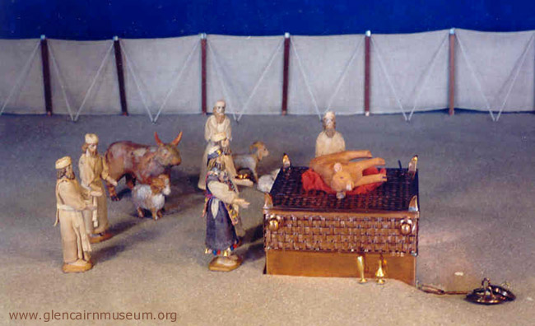
NEW COVENANT RATIFIED BY SACRIFICES
Heb 9:16, 17: (Wilson's Diaglott) “For where a Covenant exists, the Death of that which has RATIFIED it is necessary to be produced; because a Covenant is firm over dead victims, since it is never valid when that which ratifies it is alive.” (See also Rotherham and Young’s Literal Translation)
Notes:
The New Covenant too must be ratified by sacrifices.
[Read verses]

Slide 26
NEW COVENANT RATIFIED BY SACRIFICES
Heb 9:16, 17: (Wilson's Diaglott) “For where a Covenant exists, the Death of that which has RATIFIED it is necessary to be produced; because a Covenant is firm over dead victims, since it is never valid when that which ratifies it is alive.” (See also Rotherham and Young’s Literal Translation)
“CHURCH” is the New Creation; Christians who have been baptized into Christ [Romans 6] and received the Holy Spirit.
[Not a human church organization or denomination]
Notes:
The “victims” plural here are Jesus and the Church whose joint sacrifice ratifies the New Covenant. [press ENTER] When we say “Church” we are referring to the New Creation; Christians who have been baptized into Christ and received the Holy Spirit. So, in order for a covenant to go into effect, it must be ratified by sacrifices; for the New Covenant - by the sacrifice of Jesus and the Church, His body members.

Slide 27
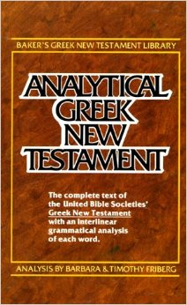
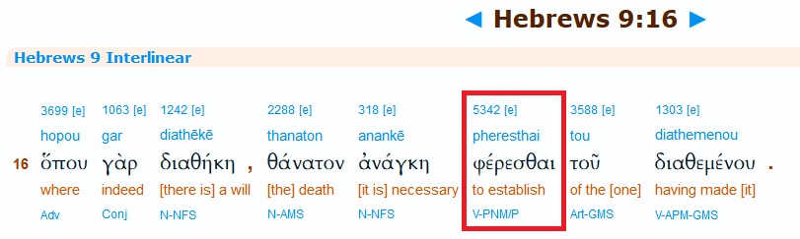
NEW COVENANT RATIFIED BY SACRIFICES
Heb 9:16, 17: (Wilson's Diaglott) “For where a Covenant exists, the Death of that which has RATIFIED it is necessary to be produced; because a Covenant is firm over dead victims, since it is never valid when that which ratifies it is alive.” (See also Rotherham and Young’s Literal Translation)
Baker’s Analytical Greek New Testament
Expression "to be produced" (Strong’s 5342) is in the PRESENT TENSE
Notes:
The expression "to be produced" is from Strong’s 5342 and is in the present tense, according to Baker’s Analytical Greek New Testament. Present tense indicates that this sacrifice, which includes the Church, was in process (not complete) at the time the Apostle Paul wrote the book of Hebrews. Consequently, the New Covenant could not have gone into operation at the time of the Early Church since the sacrifice that would ratify it was still in process & not complete.

Slide 28

WHAT IS THE NEW COVENANT?
A new contract God makes with the nation of Israel in the earthly Kingdom through which He will write His laws in their hearts and forgive their sins.
Notes:
[read question] The Jeremiah 31 “New Covenant” is a special contract that God makes with natural Israel. The reason it is called a “New Covenant” is because it's a replacement of the Old Law Covenant. In this New Covenant God promises that he'll both write His laws in their hearts and forgive their sins. The Old Law Covenant could not accomplish either of these two objectives.

Slide 29
IS THE NEW COVENANT OF JEREMIAH 31 MADE WITH THE CHURCH?
Jeremiah 31:31-32: (NKJV) “31 Behold, the days are coming, says the LORD, when I will make a new covenant with the house of Israel and with the house of Judah-- 32 "not according to the covenant that I made with their fathers in the day that I took them by the hand to lead them out of the land of Egypt, My covenant which they broke, though I was a husband to them, says the LORD.”
Notes:
[read screen]
Jeremiah 31 provides at least three facts which show that the New Covenant is not made with the Church.

Slide 30
IS THE NEW COVENANT OF JEREMIAH 31 MADE WITH THE CHURCH?
Jeremiah 31:31-32: (NKJV) “31 Behold, the days are coming, says the LORD, when I will make a new covenant with the house of Israel and with the house of Judah-- 32 "not according to the covenant that I made with their fathers in the day that I took them by the hand to lead them out of the land of Egypt, My covenant which they broke, though I was a husband to them, says the LORD.”
Notes:
1) Verse 32 refers back to the Old Law Covenant that God had made with Israel when he led them out of Egypt. However, God never made an old covenant with the Church when he led them out of the world prior to making with them a new covenant. God does not make two covenants with the New Creation as He does with natural Israel, an old and a new.

Slide 31
IS THE NEW COVENANT OF JEREMIAH 31 MADE WITH THE CHURCH?
Jeremiah 31:31-32: (NKJV) “31 Behold, the days are coming, says the LORD, when I will make a new covenant with the house of Israel and with the house of Judah-- 32 "not according to the covenant that I made with their fathers in the day that I took them by the hand to lead them out of the land of Egypt, My covenant which they broke, though I was a husband to them, says the LORD.”
Notes:
2) Verse 32 also states that they broke the Covenant. The Church never broke any previous covenant with God.

Slide 32
IS THE NEW COVENANT OF JEREMIAH 31 MADE WITH THE CHURCH?
Jeremiah 31:31-32: (NKJV) “31 Behold, the days are coming, says the LORD, when I will make a new covenant with the house of Israel and with the house of Judah-- 32 "not according to the covenant that I made with their fathers in the day that I took them by the hand to lead them out of the land of Egypt, My covenant which they broke, though I was a husband to them, says the LORD.”
Notes:
3) It speaks of God as having been a husband to Israel while they were under the Old Covenant. God was never previously a husband to the Church under some old covenant.

Slide 33
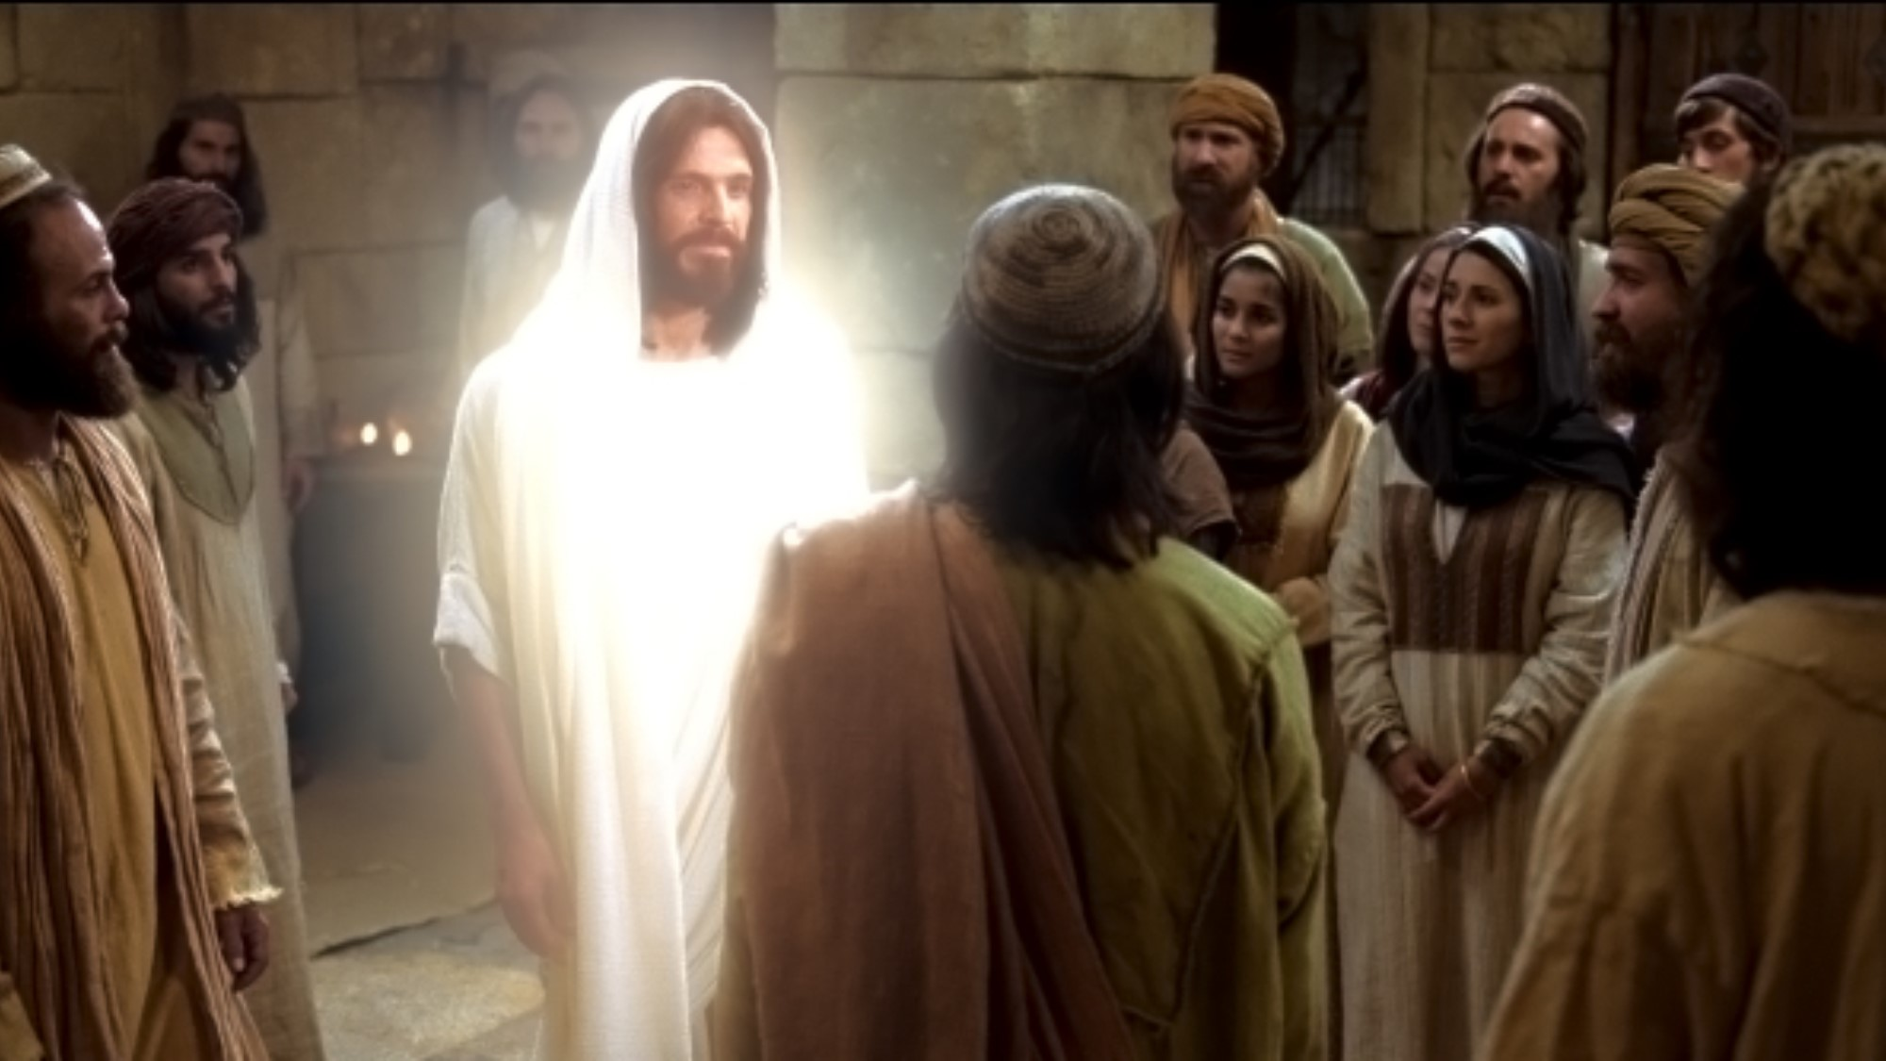
THREE REASONS JEREMIAH 31 CANNOT APPLY TO THE CHURCH
God never made an old covenant with Christians when he led them out of the world
Christians didn't break any previous covenant with God
God was never previously a husband to the New Creation
Notes:
To summarize [read screen]
In spite of these clear conflicts, most Christians believe what they have been taught, that Christians are under the New Covenant.

Slide 34
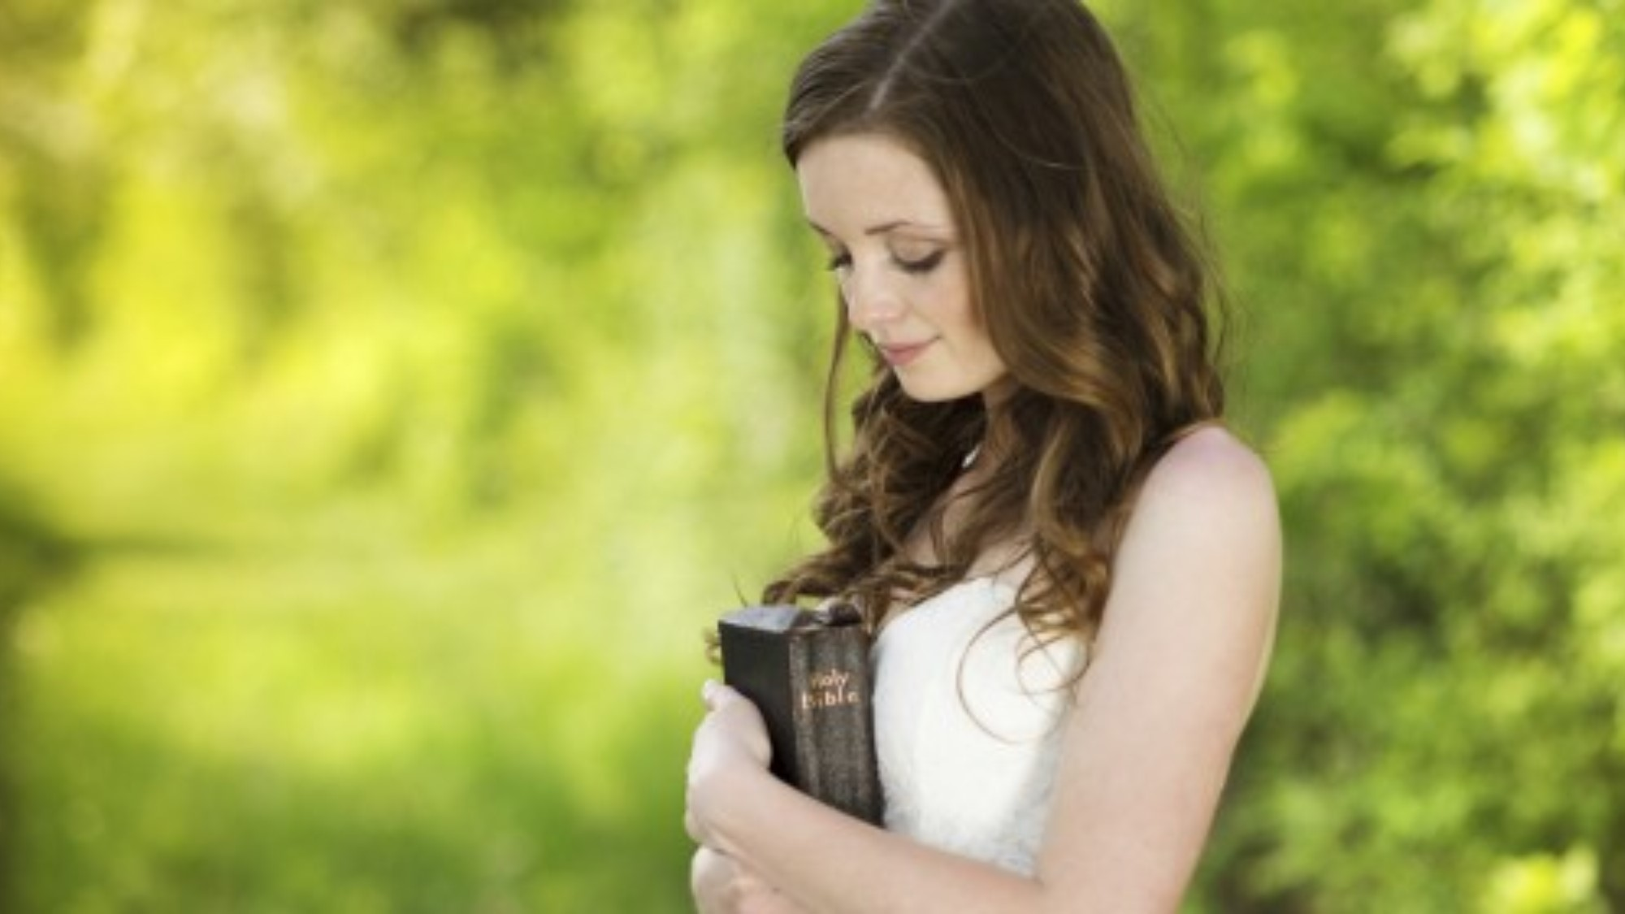
God’s law in our minds and hearts
Jeremiah 33:33-34 (NKJV) “33 "But this is the covenant that I will make with the house of Israel after those days, says the LORD: I will put My law in their minds, and write it on their hearts; and I will be their God, and they shall be My people… 34… I will forgive their iniquity, and their sin I will remember no more."
Notes:
A popular reason is found in Jeremiah 31:33 [Read verses].
These verses say that God will write his law in their minds and hearts and He will forgive their sins. Many people reason that this is all true of Christians and therefore we must all be under the New Covenant.

Slide 35
God’s Laws are written in their hearts, does NOT prove we are under the New Covenant now.
Notes:
However, we need to distinguish between Direct and Circumstantial evidence. Being under the New Covenant is not the only way to have God’s laws written in one’s heart. This is circumstantial evidence.

Slide 36
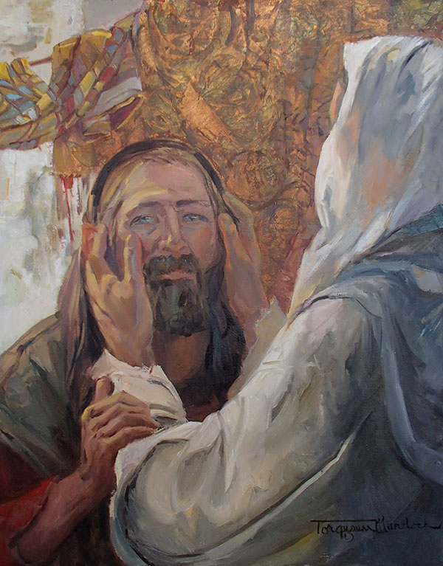
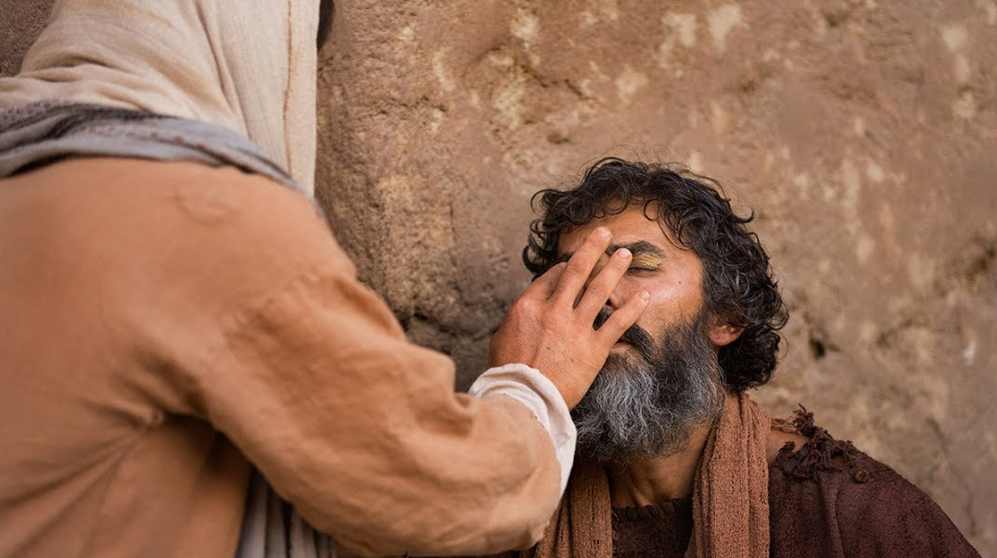
Isaiah 35 (NKJV) “5 Then the eyes of the blind shall be opened, And the ears of the deaf shall be unstopped… 8 A highway shall be there, and a road, And it shall be called the Highway of Holiness…”
Notes:
For an example of circumstantial evidence, let’s read from Isaiah 35 which is describing a future kingdom under God on earth. [Read screen] To apply Jeremiah 31 to Christians is like applying Isaiah 35:5-10 to Christians. It says that the deaf will hear and the blind will see. Although we could spiritually describe the Church in this way, Isaiah 35 itself is not about us today. Rather it is about the world of mankind walking up the Highway of Holiness (vs 8) in the future earthly kingdom.

Slide 37
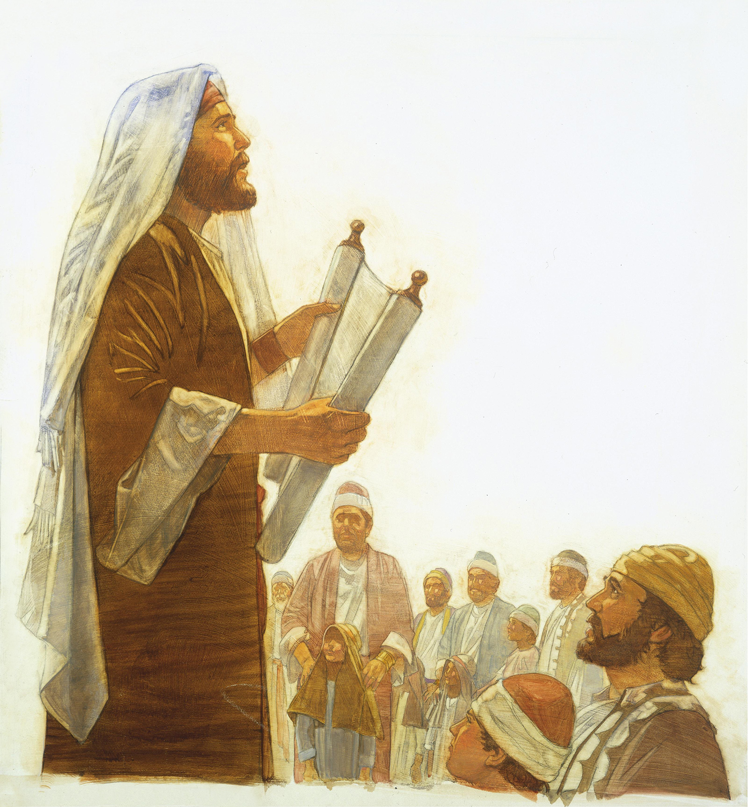
Proverbs 7:2-3 says, "Keep my commandments and live, And my teaching as the apple of your eye. Bind them on your fingers; Write them on the tablet of your heart."
The Jews were to have God’s laws written in their hearts under the Law Covenant. However, that does not prove they were under the New Covenant back then.
Notes:
It has always been true that people need to have God's laws written on their hearts. Notice how Proverbs 7:2-3 says [Read Proverbs 7]. Were the Jews who followed this admonition to write God’s commandments on their heart under the New Covenant? Of course not. They were still under the old Law Covenant.

Slide 38
Jeremiah 33:33-34 (NKJV) “33 "But this is the covenant that I will make with the house of Israel after those days, says the LORD: I will put My law in their minds, and write it on their hearts; and I will be their God, and they shall be My people… 34… I will forgive their iniquity, and their sin I will remember no more."
Notes:
The circumstantial evidence that God will write his law in their minds and hearts and he will forgive their sins does not prove the Church is under the New Covenant. We need to look at all the evidence before drawing a conclusion.

Slide 39
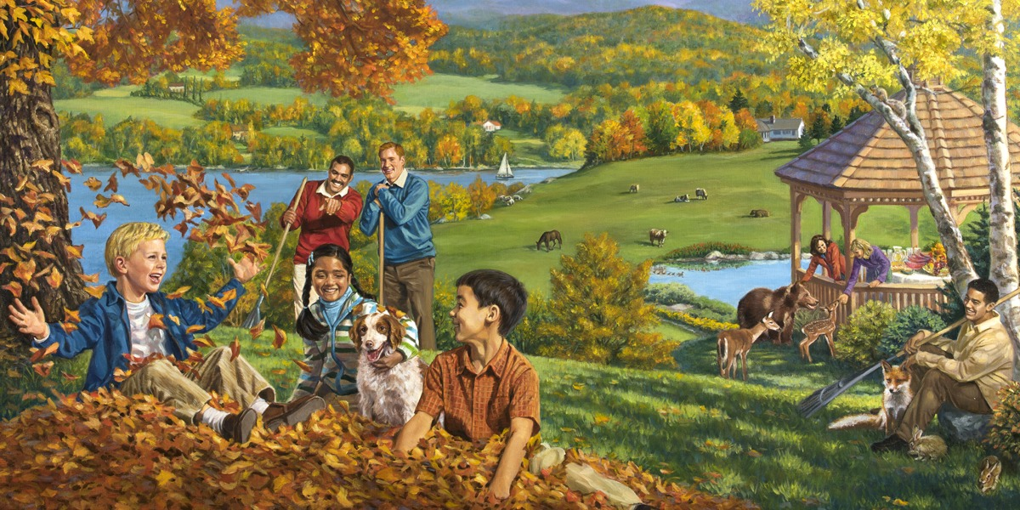
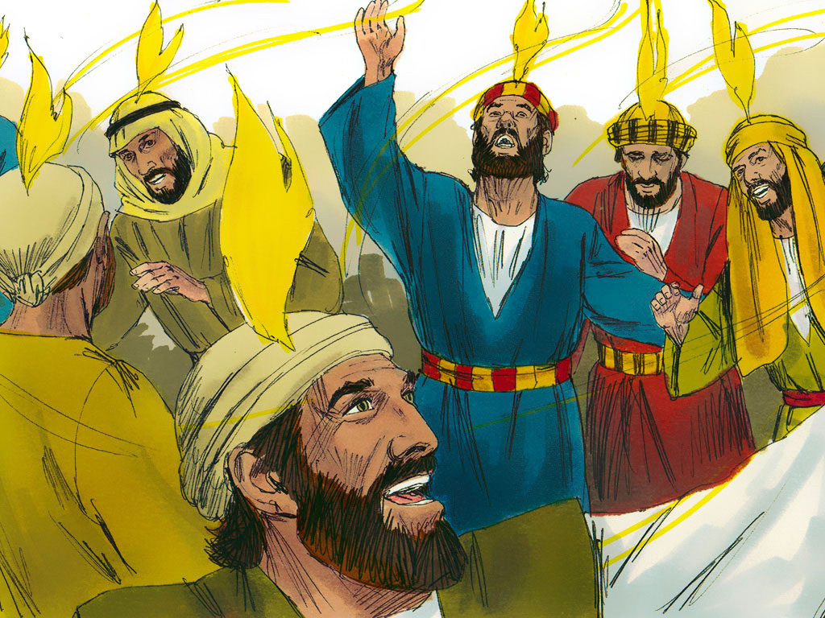
WHEN IS THE NEW COVENANT MADE?
Notes:
[read question] This is a vital question. If the Church is under the New Covenant, then this covenant cannot be in the future, but would have had to be in effect no later than Pentecost. This question can be answered by looking at the context in which the New Covenant prophecy is placed.

Slide 40
WHEN IS THE NEW COVENANT MADE?
Jer. 30:1: “The word that came to Jeremiah from the LORD...”
Jer. 32:1: “The word that came to Jeremiah from the LORD...”
Notes:
We need to begin a chapter earlier where Jeremiah’s prophecy begins. Jeremiah 30:1 starts out with [Read Jer 30:1] Chapter 32 begins a new prophecy. Let’s carefully examine this prophecy which we will find does NOT apply chapters 30 and 31 to the Church at Pentecost, but rather to natural Israel at the time of the future kingdom on earth under God’s rule.

Slide 41
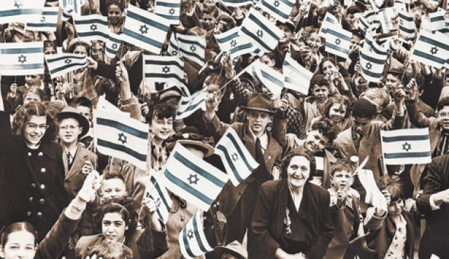
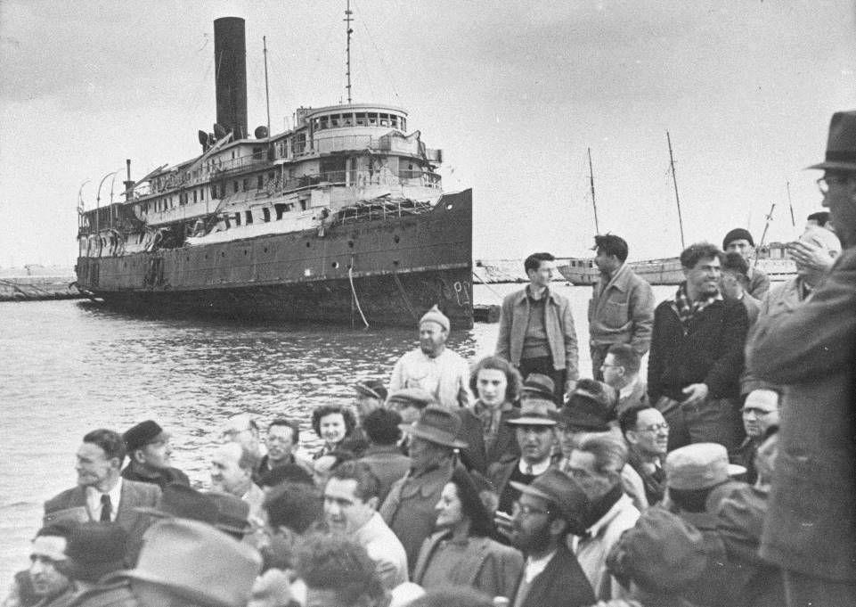
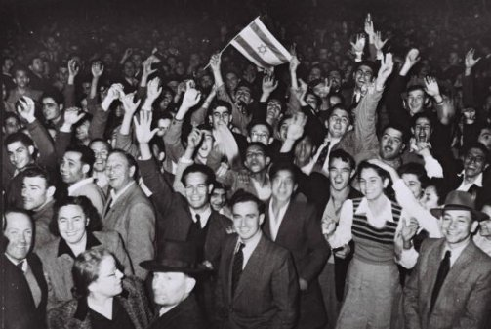
WHEN IS THE NEW COVENANT MADE?
Jeremiah 30:3: “For, lo, the days come, saith the LORD, that I will bring again the captivity of my people Israel and Judah, saith the LORD; and I will cause them to return to the land that I gave to their fathers, and THEY SHALL POSSESS IT.”
Notes:
[read verse] Verse 3 is referring to natural Israel returning to their land just prior to the kingdom and possessing it; not like their return from the Babylonian captivity where they were unable to really possess it, being under the domination of the Greeks and Romans.

Slide 42
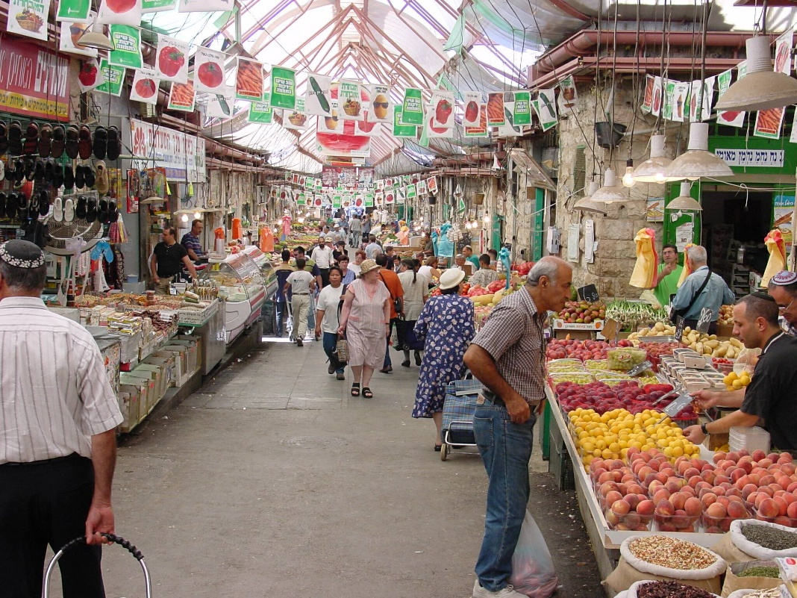
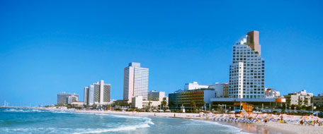
WHEN IS THE NEW COVENANT MADE?
Jeremiah 30:11: For I am with thee, saith the LORD, to save: though I make a full end of all nations whither I have scattered thee, yet will I not make a full end of thee: but I will correct thee in measure, and will not leave thee altogether unpunished."
Notes:
[read verse] The text refers to God making a full end of all nations where Israel has been scattered. The time when God makes this full end of these nations is the end of the Gospel age, not beginning at Pentecost. (See Zech 12:9; 14:3.)

Slide 43
WHEN IS THE NEW COVENANT MADE?
Jeremiah 30:11: For I am with thee, saith the LORD, to save: though I make a full end of all nations whither I have scattered thee, yet will I not make a full end of thee: but I will correct thee in measure, and will not leave thee altogether unpunished."
Notes:
Notice also how Jeremiah says that God will correct Israel in measure and won't leave them unpunished. This is speaking of the punishment Israel has received being cast off from their land by the Roman Armies and persecuted by their host nations (Ez 39:25-29).

Slide 44
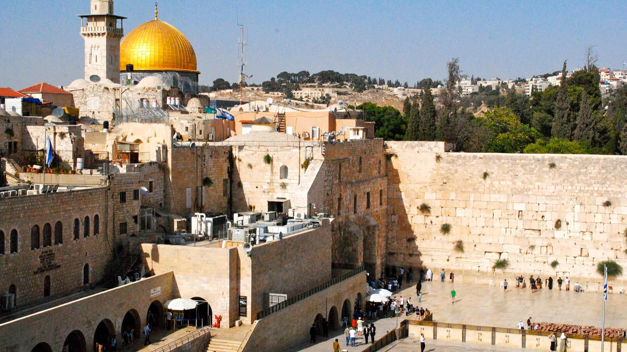
WHEN IS THE NEW COVENANT MADE?
Jer 31:27-28 (AKJV) “27 Behold, the days come, saith the LORD, that I will sow the house of Israel and the house of Judah with the seed of man, and with the seed of beast.
28 And it shall come to pass, that like as I have watched over them, to pluck up, and to break down, and to throw down, and to destroy, and to afflict; so will I watch over them, to build, and to plant, saith the LORD.”
Notes:
[read verses] The Church was never plucked up and thrown down and destroyed by the Lord. However this fits perfectly for the history of natural Israel since the nation was destroyed and the people scattered by the Roman armies.

Slide 45

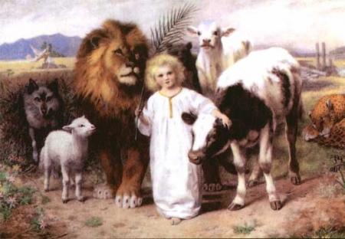
WHEN IS THE NEW COVENANT MADE?
Other verses as well which place the context at the end of the Gospel Age - Jeremiah 30:9; 31:6-11, 28, 29
Notes:
Other Bible verses listed on the screen also place the context at the end of the Gospel Age and the beginning of the earthly kingdom (Jeremiah 30:9; 31:6-11, 28, 29). Hence we believe that the New Covenant does not become operative until the time of the earthly kingdom is first established in Israel.

Slide 46
WHEN IS THE NEW COVENANT MADE?
Scriptures speak of the New Covenant with Israel in kingdom -Jer 32:37-40; Ez 16:59-63; Ez 20:33-38; Ez 37:23-28; Isa 55:3-5
Notes:
Many other Old Testament passages speak of the New Covenant as being established with Israel at the time of the kingdom. We don't have time to read these passages, but after reading them on your own time we believe you'll agree that the Old Testament does not indicate that the Church is under the New Covenant.

Slide 47
THE NEW COVENANT IN ROMANS 11
Rom 11:25-29 (NKJV) “25 … blindness in part has happened to Israel until the fullness of the Gentiles has come in. 26 And so all Israel will be saved, as it is written: "The Deliverer will come out of Zion, And He will turn away ungodliness from Jacob; 27 For this is My covenant with them, When I take away their sins." 28 Concerning the gospel they are enemies for your sake, but concerning the election they are beloved for the sake of the fathers. 29 For the gifts and the calling of God are irrevocable.”
Notes:
Let’s investigate to see if we find further evidence in the New Testament to be consistent. To whom does Paul apply the New Covenant in Romans 11? Do we find any hint that God makes the New Covenant with the Church? [Read scriptures] Paul shows in vs 25 that the New Covenant will NOT be made “until the fullness of the Gentiles come in,” that is, when the Church is complete and the door is closed to the heavenly call.

Slide 48
THE NEW COVENANT IN ROMANS 11
Rom 11:25-29 (NKJV) “25 … blindness in part has happened to Israel until the fullness of the Gentiles has come in. 26 And so all Israel will be saved, as it is written: "The Deliverer will come out of Zion, And He will turn away ungodliness from Jacob; 27 For this is My covenant with them, When I take away their sins." 28 Concerning the gospel they are enemies for your sake, but concerning the election they are beloved for the sake of the fathers. 29 For the gifts and the calling of God are irrevocable.”
Notes:
Verses 26 and 27 show that God will save Israel, take away their sins and establish the New Covenant with them.

Slide 49
THE NEW COVENANT IN ROMANS 11
Rom 11:25-29 (NKJV) “25 … blindness in part has happened to Israel until the fullness of the Gentiles has come in. 26 And so all Israel will be saved, as it is written: "The Deliverer will come out of Zion, And He will turn away ungodliness from Jacob; 27 For this is My covenant with them, When I take away their sins." 28 Concerning the gospel they are enemies for your sake, but concerning the election they are beloved for the sake of the fathers. 29 For the gifts and the calling of God are irrevocable.”
Notes:
Paul nails down his argument about Israel being favored under the New Covenant by stating in verse 29, “the gifts and calling of God are irrevocable". In other words, since God promised this New Covenant to Israel in the Old Testament, He won't go back on his word. Paul exclusively applies the New Covenant in this chapter to natural Israel, and makes no reference to the Church as being under it. If the New Creation truly were under the New Covenant, we would have expected Paul to have stated so here.

Slide 50
HOW IS JESUS A SURETY OF A BETTER COVENANT?
Hebrews 7:22: (Wilson's Diaglott) “…but by so much has Jesus become the PLEDGE of a Better Covenant.”
Strong's #1450: pledged (as if articulated [joined] by a member) i.e. a bondsman
R. Milligan, New Testament Commentary, Vol. IX: the word egguos does not occur elsewhere in the New Testament; but in classic Greek it means a surety, a sponsor, or a bondsman: one who pledges his name, property, or influence that a promise SHALL BE FULFILLED, or that something else SHALL BE DONE.
Notes:
Does the fact that Jesus is a surety of the New Covenant have any bearing on whether or not the New Covenant is now operative with the Church? [Read Heb 7:22] The word PLEDGE here is translated SURETY in the King James and many other translations. [Press ENTER twice and read each citation]

Slide 51
HOW IS JESUS A SURETY OF A BETTER COVENANT?
Hebrews 7:22: (Wilson's Diaglott) “…but by so much has Jesus become the PLEDGE of a Better Covenant.”
Strong's #1450: pledged (as if articulated [joined] by a member) i.e. a bondsman
R. Milligan, New Testament Commentary, Vol. IX: the word egguos does not occur elsewhere in the New Testament; but in classic Greek it means a surety, a sponsor, or a bondsman: one who pledges his name, property, or influence that a promise SHALL BE FULFILLED, or that something else SHALL BE DONE.
Notes:
So a surety is a pledge, deposit or guarantee that some promise will be fulfilled in the FUTURE. If the New Covenant were in operation in Paul's day, Jesus would not have been needed as a surety. Therefore the Early Church was not under the New Covenant and nor can we be today.

Slide 52
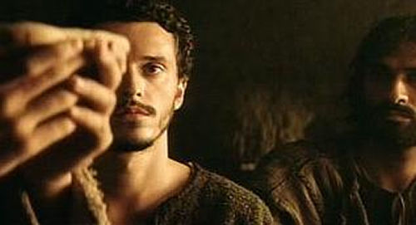
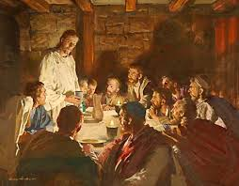
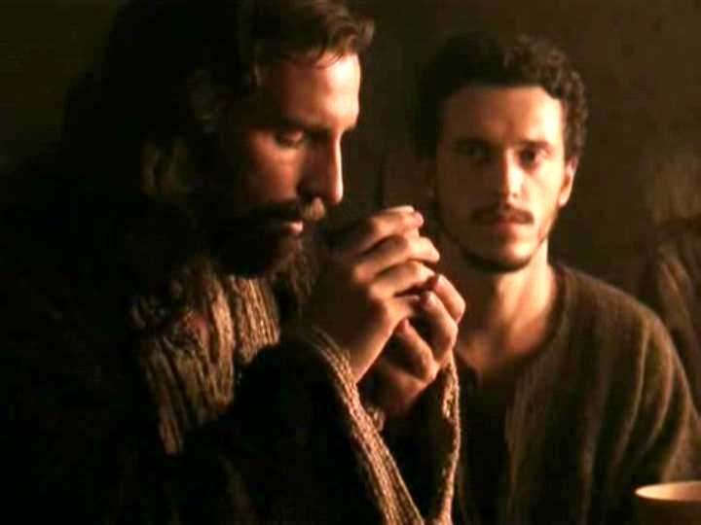
DOES DRINKING THE BLOOD OF THE COVENANT MEAN WE ARE UNDER IT?
Matt 26:27,28 (NASV) “And when He had taken a cup and given thanks, He gave it to them, saying, "Drink from it, all of you; for this is My blood of the covenant, which is poured out for many for forgiveness of sins.”
Notes:
[Read screen] This passage has thoroughly convinced many that the Church is under the New Covenant. Notice though, this text nowhere states that God will make the New Covenant with the Church. The conclusion some draw is that since the Church drinks of the blood of the New Covenant, this means they are under it. Yet, we ask for evidence. Where does the Bible show that drinking blood represents being under a covenant?

Slide 53
DOES DRINKING THE BLOOD OF THE COVENANT MEAN WE ARE UNDER IT?
Matt 26:27,28 (NASV) “And when He had taken a cup and given thanks, He gave it to them, saying, "Drink from it, all of you; for this is My blood of the covenant, which is poured out for many for forgiveness of sins.”
Notes:
Quite to the contrary, as we shall see from scriptures, drinking blood represents participation in Christ's sacrifice. This text therefore does not prove that we are under the New Covenant, but rather, it shows our participation in the sacrifice that ratifies the New Covenant.

Slide 54
DOES DRINKING THE BLOOD OF THE COVENANT MEAN WE ARE UNDER IT?
Mark 10:38: “But Jesus said unto them, Ye know not what ye ask. Can ye drink of the cup that I drink of? and be baptized with the baptism that I am baptized with?”
John 18:11: “Then said Jesus unto Peter, Put up thy sword into the sheath: the cup which my Father hath given me, shall I not drink it?”
Matthew 26:39: “And he went a little farther, and fell on his face, and prayed, saying, O my Father, if it be possible, let this cup pass from me! nevertheless, not as I will, but as though will.”
Notes:
Let's look at scriptures which support the view that drinking blood represents participation in sacrifice. [Read verses] All three of the texts reveal that drinking of the cup represents Christ's sacrifice or our participation with Christ in His sacrifice. The common rebuttal is that these verses have nothing to do with the cup drank at our Lord's memorial supper.

Slide 55
DOES DRINKING THE BLOOD OF THE COVENANT MEAN WE ARE UNDER IT?
Mark 10:38: “But Jesus said unto them, Ye know not what ye ask. Can ye drink of the cup that I drink of? and be baptized with the baptism that I am baptized with?”
John 18:11: “Then said Jesus unto Peter, Put up thy sword into the sheath: the cup which my Father hath given me, shall I not drink it?”
Matthew 26:39: “And he went a little farther, and fell on his face, and prayed, saying, O my Father, if it be possible, let this cup pass from me! nevertheless, not as I will, but as though will.”
Notes:
Really? The last two texts quoted occurred shortly after the memorial supper. If these verses do not relate to the memorial cup, we might as well discard our practice of contextual harmony and of scripture interpreting scripture. Do we really think that shortly after having shared the cup with the disciples, that when Jesus again refers to the cup at Gethsemane, that He makes no connection? That the cups are unrelated?

Slide 56
DOES DRINKING THE BLOOD OF THE COVENANT MEAN WE ARE UNDER IT?
1 Corinthians 10:16: (NASV) “The cup of blessing which we bless, is it not the communion of the blood of Christ?”
Phil 3:10 (NASV) “…that I may know Him and the power of His resurrection and the fellowship of His sufferings, being conformed to His death;”
Notes:
We find further support in [Read 1 Cor 10:16] The word "communion" has the thought in the Greek of sharing or common participation. [press ENTER, Read Phil 3:10] The same Greek word is used in Phil 3:10 where Paul speaks of us having a "fellowship" or common participation in Christ's sufferings.

Slide 57
DOES DRINKING THE BLOOD OF THE COVENANT MEAN WE ARE UNDER IT?
1 Corinthians 10:16: (NASV) “The cup of blessing which we bless, is it not the communion of the blood of Christ?”
Phil 3:10 (NASV) “…that I may know Him and the power of His resurrection and the fellowship of His sufferings, being conformed to His death;”
SACRIFICES RATIFY COVENANTS
Notes:
So in all verses we cited, drinking of the cup represents participation in sacrifice. 1 Cor 10:16 directly ties in this thought of common participation with the memorial cup. [Press ENTER twice] Our drinking of the cup demonstrates that our relationship to the New Covenant is that of sacrificers. Since sacrifices ratify covenants, the Church's sacrifice (as Christ's body members), with their head, is what ratifies the New Covenant.

Slide 58

DID JESUS DRINK THE CUP OF THE NEW COVENANT?
Notes:
[read question] This question may seem trivial, but actually it is quite important to our discussion. Many of those who believe that the Church is under the New Covenant strongly argue that Jesus definitely did not drink of the cup. Why do they take such a strong position?

Slide 59

DID JESUS DRINK THE CUP OF THE NEW COVENANT?
Notes:
Think about it. If our drinking of the cup is used as proof that we are under the New Covenant, then that must mean Jesus is also under the New Covenant if he drank of the cup. Jesus of course cannot be under the New Covenant, so therefore they conclude that Jesus did not drink the cup, even if the Church did.

Slide 60



DID JESUS DRINK THE CUP OF THE NEW COVENANT?
Mk 14:25: (AKJV) “Verily I say unto you, I will drink no more of the fruit of the vine, until that day that I drink it new in the kingdom of God.”
Notes:
What do the scriptures say? [Read Mark 14:25] Notice two points from this scripture. First, Jesus says he will drink no more of the cup. The fact that he won't drink any more until the kingdom indicates that had already drank of the cup, else how could he drink of it no more.

Slide 61
DID JESUS DRINK THE CUP OF THE NEW COVENANT?
Mk 14:25: (AKJV) “Verily I say unto you, I will drink no more of the fruit of the vine, until that day that I drink it new in the kingdom of God.”
Notes:
Second, Jesus says he won't drink with them again until he drinks the cup new with them. If he promises to drink it new, there must have been a time when he drank it old. Therefore, Jesus did indeed drink of the cup on the Passover night.

Slide 62
DID JESUS DRINK THE CUP OF THE NEW COVENANT?
Mark 14:25: (AKJV) “Verily I say unto you, I will drink no more of the fruit of the vine, until that day that I drink it new in the kingdom of God.”
Mark 10:38: “But Jesus said unto them, Ye know not what he ask. Can ye drink of the cup that I DRINK OF? and be baptized with the baptism that I am baptized with?” (See John 18:11) 18:11)
Notes:
This is in harmony with Jesus’ clear statement. [Read Mark 10:38] Drinking the cup does not place Jesus under the New Covenant, but rather makes him the sacrifice that ratifies it. So likewise with us. The Church is not under the New Covenant, but as his body members, we participate in ratifying that covenant.

Slide 63

IS THE CHURCH’S ROLE IN RELATION TO THE NEW COVENANT THE SAME AS JESUS' ROLE?
Notes:
[Read title] To find the answer, let's take a careful look at Luke 22.

Slide 64
IS THE CHURCH’S ROLE IN RELATION TO THE NEW COVENANT THE SAME AS JESUS' ROLE?
Luke 22:20 (NKJV) “Likewise He also took the cup after supper, saying, ‘This cup is the new covenant in My blood, which is shed for you.’’’
Luke 22:29 (KJV) “And I appoint unto you a kingdom, as my Father hath appointed unto me…”
“appoint” Strong’s 1303 mistranslated “Testator” in Hebrews 9:16
Notes:
[Read verses] The word “appoint” is not accurate. [Press ENTER] It is the same word mistranslated “Testator” in Hebrews 9:16 (Strong’s 1303) and the real meaning of the word is “covenant sacrifice.” That’s what we are; covenant sacrificers with Christ, who ratify the New Covenant.

Slide 65
IS THE CHURCH’S ROLE IN RELATION TO THE NEW COVENANT THE SAME AS JESUS' ROLE?
Luke 22:20 (NKJV) “Likewise He also took the cup after supper, saying, ‘This cup is the new covenant in My blood, which is shed for you.’’’
Luke 22:29 (KJV) “And I appoint unto you a kingdom, as my Father hath appointed unto me…”
“appoint” Strong’s 1303 mistranslated “Testator” in Hebrews 9:16
Luke 22:29 (Rotherham) “And I covenant (Strong’s 1303) unto you as my Father hath covenanted (Strong’s 1303) unto me a kingdom…”
Notes:
Rotherham translates closer to the real meaning: [Read Luke 22:29] We conclude then that the Church’s role in relation to the new Covenant is the same as Jesus's role. Luke 22:29 says that Jesus has covenanted unto us, just in the same way as the Father has covenanted unto Him.

Slide 66
IS THE CHURCH’S ROLE IN RELATION TO THE NEW COVENANT THE SAME AS JESUS' ROLE?
Luke 22:20 (NKJV) “Likewise He also took the cup after supper, saying, ‘This cup is the new covenant in My blood, which is shed for you.’’’
Luke 22:29 (KJV) “And I appoint unto you a kingdom, as my Father hath appointed unto me…”
“appoint” Strong’s 1303 mistranslated “Testator” in Hebrews 9:16
Luke 22:29 (Rotherham) “And I covenant (Strong’s 1303) unto you as my Father hath covenanted (Strong’s 1303) unto me a kingdom…”
Notes:
Jesus’ relationship to the New Covenant is the same as our relationship to the New Covenant. In other words as “covenant sacrificers” ratifying the New Covenant, Jesus and His body members make possible the future earthly Kingdom, through the New Covenant arrangement.

Slide 67


HAVE WE ARRIVED AT MOUNT ZION?
Exodus 19:17, 20: “And Moses brought the people out of the camp to meet God, and they stood at the foot of the mountain ... And the LORD came down on Mount Sinai, to the top of the mountain; and the LORD called Moses to the top of the mountain, and Moses went up.”
Notes:
[Read question and verse] Here Moses went up Mount Sinai to receive the Law Covenant. Of this event, we read in Hebrews 12:22 the reality of what it represents.

Slide 68

HAVE WE ARRIVED AT MOUNT ZION?
Hebrews 12:22, 24 (NASV) “22 But you have come to Mount Zion … 24 and to Jesus, the mediator of a new covenant, and to the sprinkled blood…”
Notes:
[Read verses]

Slide 69
HAVE WE ARRIVED AT MOUNT ZION?
Hebrews 12:22, 24 (NASV) “22 But you have come to Mount Zion … 24 and to Jesus, the mediator of a new covenant, and to the sprinkled blood…”
“have come” Strong’s 4334 means to “approach” or “come near”
Henry Alford’s “Greek Testament: An Exegetical and Critical Commentary” also renders it “but ye have drawn near…” Then he notes this is the same sense that Israel drew near or approached in Deut 4:11.
Notes:
In the NASV, Hebrews 12:22 says, "you have come to Mount Zion." Some take this to mean that we have arrived at Mount Zion, but this is not the force of the Greek. [Read Strong’s and Henry Alford]. So we have not ARRIVED, but are drawing near in the sense that we give assent, agree and are in accord with; but we are not now on that New Covenant Mountain. That will only be when the church is complete and administers it from the heavenly Jerusalem, as noted in verse 23.

Slide 70

HAVE WE ARRIVED AT MOUNT ZION?
Hebrews 12:22-24 (NASV) “22 But you have come are drawing near to Mount Zion… the heavenly Jerusalem… 24 and to Jesus, the mediator of a new covenant, and to the sprinkled blood…”
Notes:
Paul said “ye are drawing near (during the Gospel Age) to mount Zion, and unto the city of the living God, the heavenly Jerusalem (when the New Covenant will be ratified and operational)” He is not saying we are now or ever will be under the New Covenant. But we are indeed drawing near to that city that will have the ratified covenant and we will be part of its mediator.

Slide 71
SUMMARY – OUR ROLE IN GOD’S COVENANTS
A Bible Covenant is a contract ratified by sacrifices.
The Jeremiah 31 New Covenant is made with Natural Israel.
Per Romans 11, the New Covenant is made with Natural Israel after the Church’s sacrifice is complete (when the earthly kingdom is established).
There would be no need for Jesus to now be the “surety” or “guarantee” of the New Covenant if it were already operational.
Drinking the Cup shows the Church with Jesus ratify the New Covenant
Hebrew 12 shows we are drawing near to, but have not yet arrived at, Mount Zion and the New Covenant.
No Bible verse in the New Testament says that God makes the New Covenant with the Church.
Notes:
[Read Summary]
Look for part 2 of “Our Role in God’s Covenants” coming in early 2019.
May the Lord add his blessing.

Slide 72
OUR ROLE IN GOD’S COVENANTS – Part 1
Moses
Jesus
Noah
Abraham

Slide 73

Hymn 164 - Hear The Call

Slide 74

Lo! the day of God is breaking;
See the gleaming from afar!

Slide 75

Sons of earth from slumber waking,
Hail the bright and Morning Star.

Slide 76

CHORUS
Hear the call! O gird your armor on,
Grasp the Spirit's mighty sword;
Take the helmet of salvation,
Pressing on to battle for the Lord!

Slide 77

Trust in him who is your Captain;
Let no heart in terror quail;

Slide 78

Jesus leads the gath'ring legion,
In his name we shall prevail.

Slide 79
CHORUS
Hear the call! O gird your armor on,
Grasp the Spirit's mighty sword;
Take the helmet of salvation,
Pressing on to battle for the Lord!

Slide 80

Onward marching, firm and steady,
Faint not, fear not Satan's frown,

Slide 81

For the Lord is with you always,
Till you wear the victor's crown.

Slide 82
CHORUS
Hear the call! O gird your armor on,
Grasp the Spirit's mighty sword;
Take the helmet of salvation,
Pressing on to battle for the Lord!

Slide 83

Conq'ring bands with banners waving,
Pressing on o'er hill and plain,

Slide 84

Ne'er shall halt till swells the anthem,
"Christ o'er all the earth doth reign!"

Slide 85
CHORUS
Hear the call! O gird your armor on,
Grasp the Spirit's mighty sword;
Take the helmet of salvation,
Pressing on to battle for the Lord!

Slide 86
OUR ROLE IN GOD’S COVENANTS – Part 1
Moses
Jesus
Noah
Abraham
Notes:
Today we would like to first discuss God’s covenants in general, then next how any of these covenants may relate to us, and finally, we want to answer the question, “Who is under the New Covenant?”

